Slide 1

Decision and Risk Analytics Project by Group 7
Presented by-
Chandhini Kerachan Muraleedharan

Slide 2


Join a startup or Corporate Job after Graduation
Objectives:
Career Advancement
Job Satisfaction
Total Compensation – Salary
Decision Maker:
Micah
Methodology:
Decision with precision tree
And expected utility calculations using swing weights

Slide 3
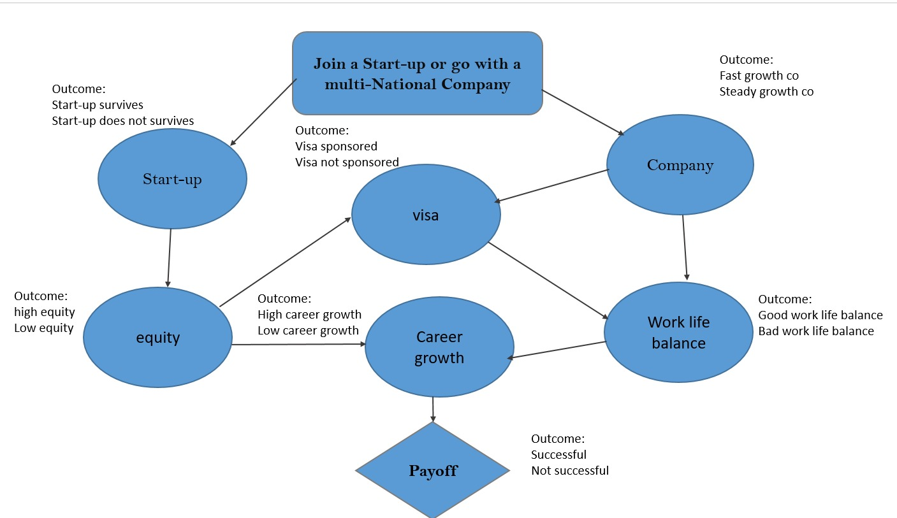
Influence Diagram

Slide 4
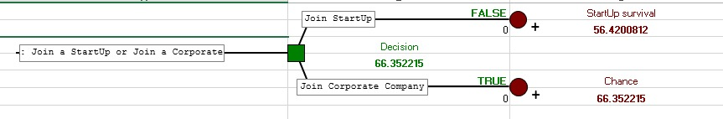
Main Decision

Slide 5
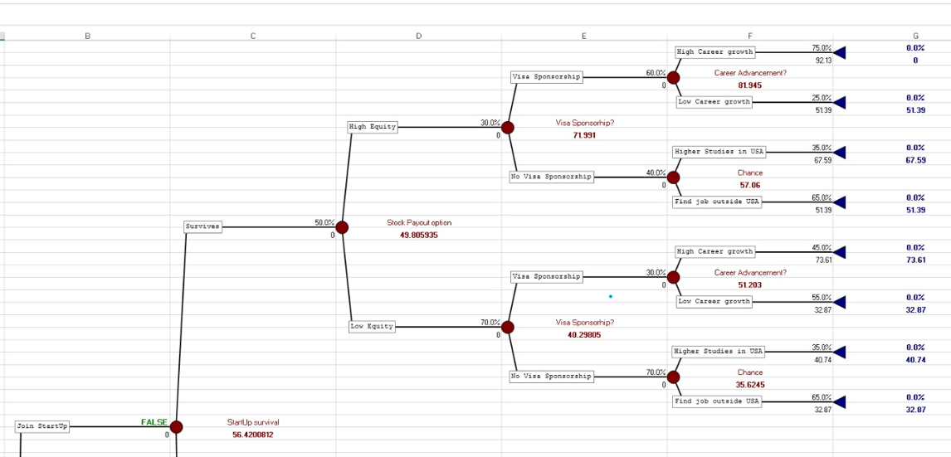
Startup Survival

Slide 6
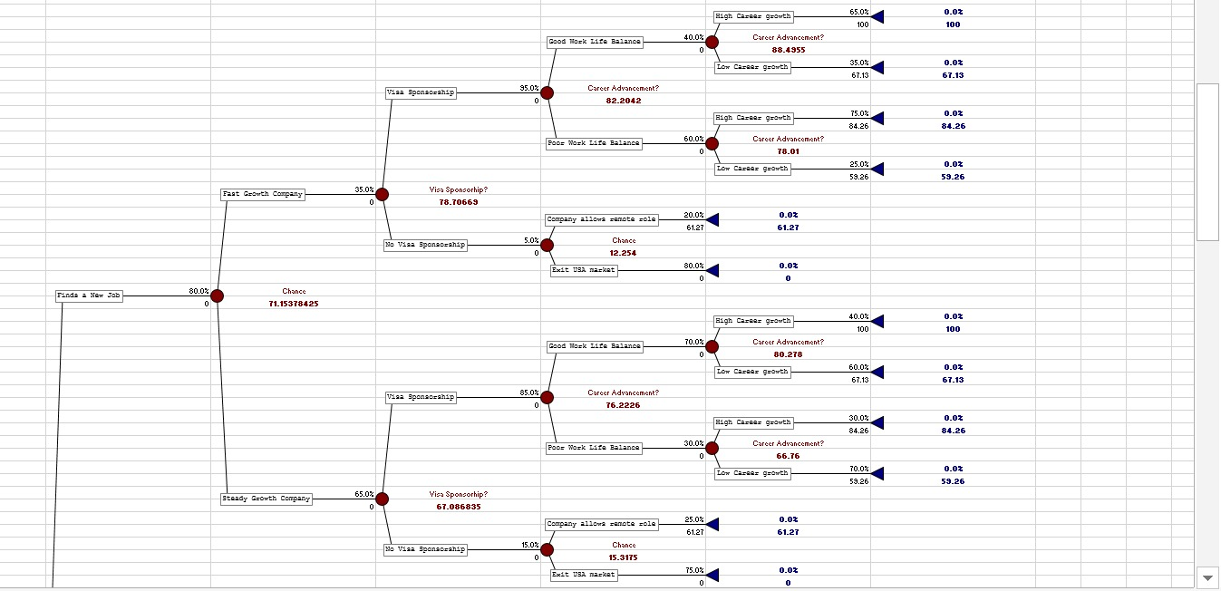
Startup Failure

Slide 7
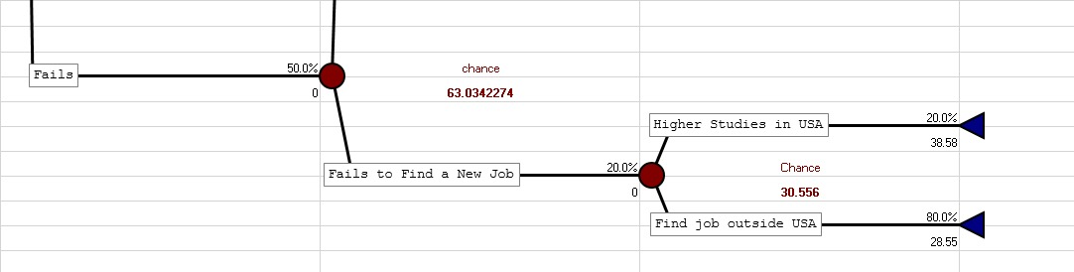
Startup Failure

Slide 8
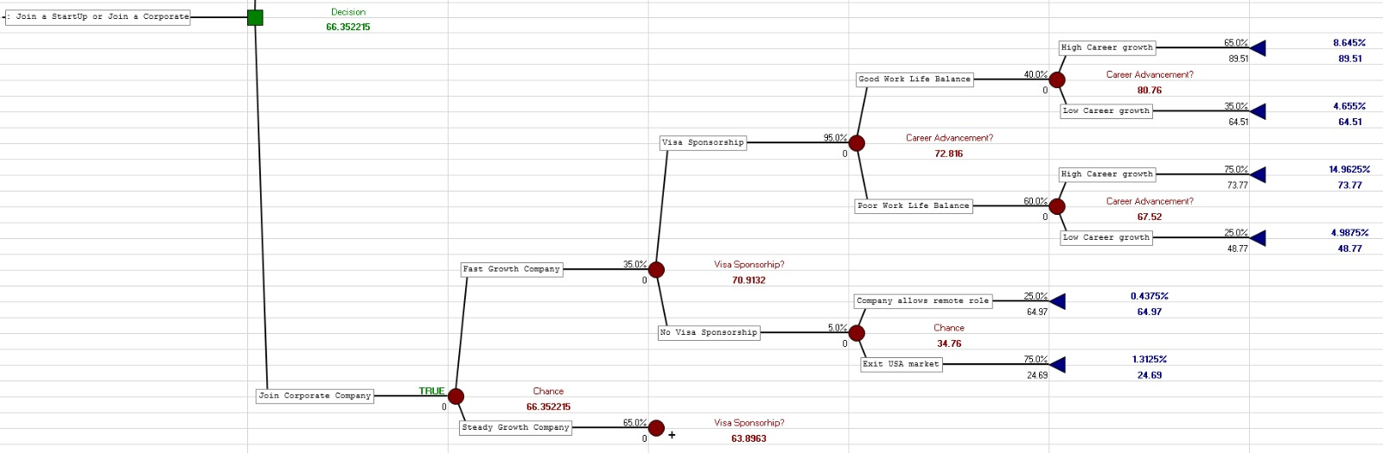
Join Corporate – Fast Growth Company

Slide 9
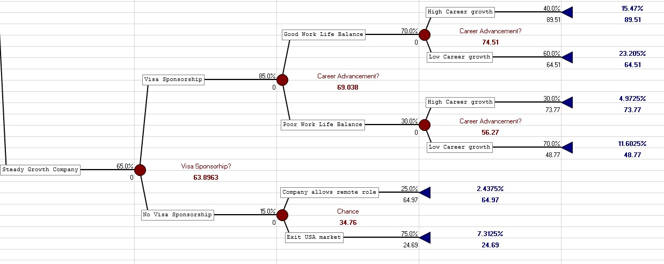
Join Corporate – Steady Growth Company

Slide 10
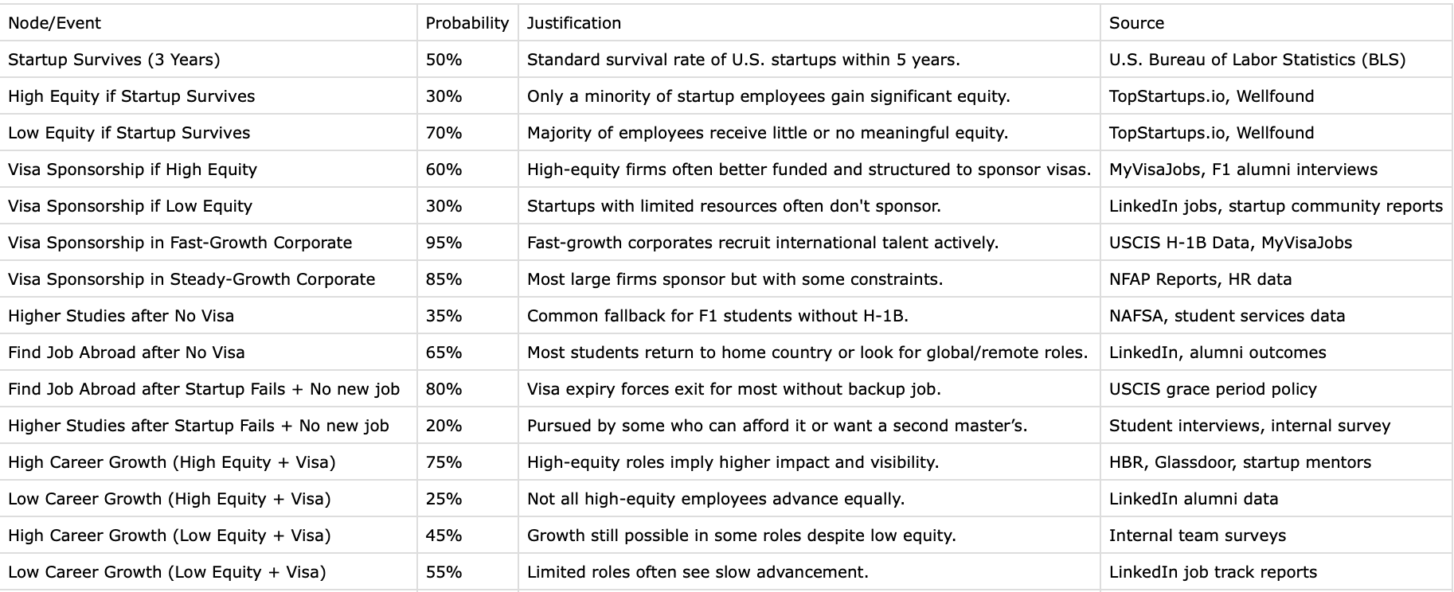
Probabilities Data

Slide 11
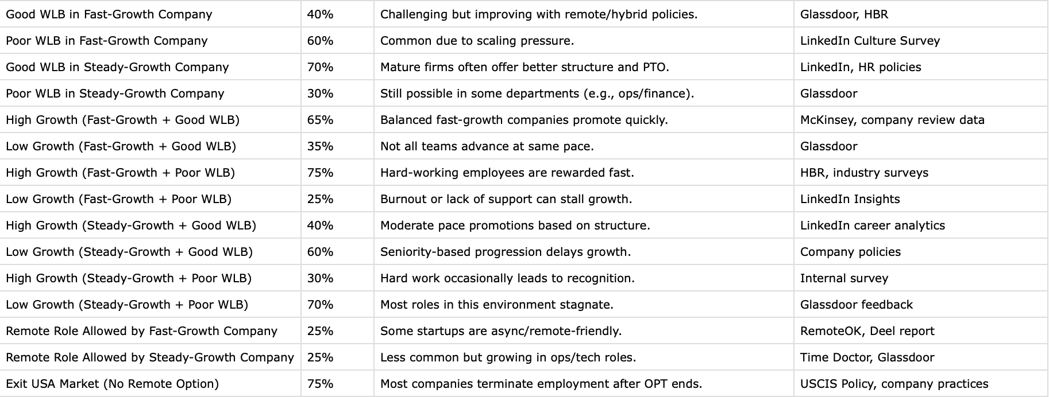

Slide 12
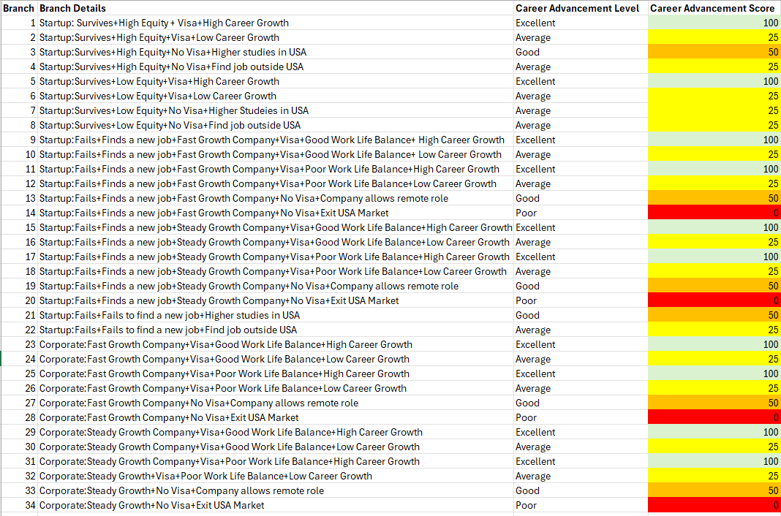
Calculation of final utility ( using swing weights)
Objective 1: Career Advancement
Excellent- 100
High Career Growth
Higher Studies in USA
Company allows remote role
Good- 50
Higher studies in USA
Company allows remote role
Average- 25
Low career growth
Find job outside USA
Poor- 0
1. Exit USA Market

Slide 13
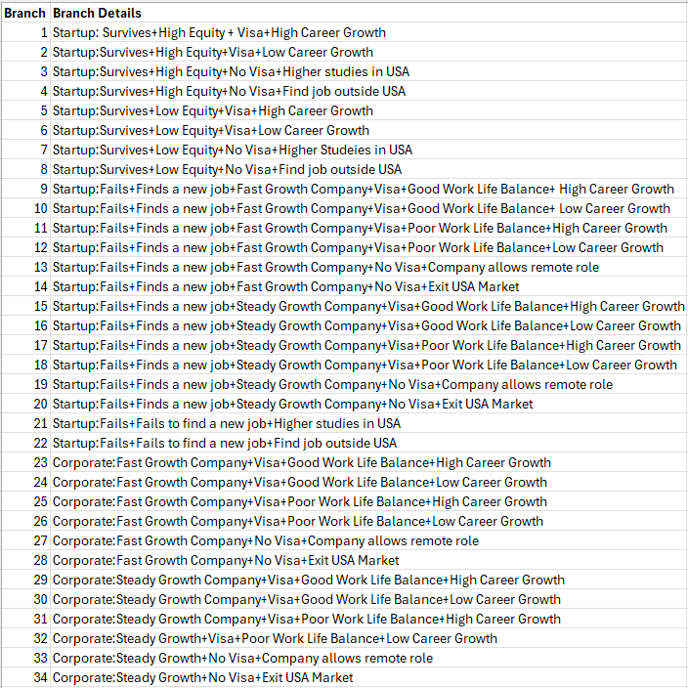
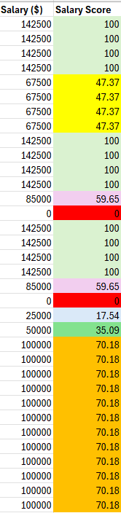
Objective 2: Total Compensation/ Salary
Salary | Salary Utility Calculation | Value
Startup with high equity | 142500 | 100
Startup with low equity | 67500 | 47.37
Job in USA | 1,00,000 | 70.18
Job outside USA | 50000 | 35.09
Remote Job | 85000 | 59.65
Calculation:
Salary Utility:
=(Salary/142500)*100
Startup with High Equity:
=(142500)/(142500)*100=100
Startup with Low Equity:
=(67500)/(142500)*100=47.37

Slide 14
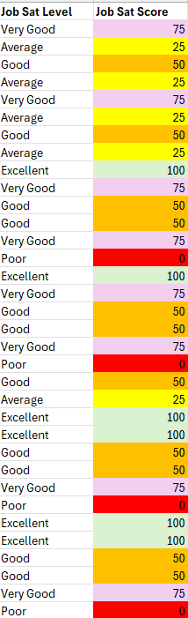
Objective 3: Job Satisfaction
Excellent- 100
Work balanced and stress free.
Good Work life bal + visa
Very Good- 75
1. Career Growth is exciting and rewarding
High career growth and visa
2. Work is balanced and stress free but slow progress at work
Good Work Life Balance + low career growth
3. Remote Work-
Flexible and comfortable
Good- 50
Higher Studies – meaningful and useful for long term job
Job is ok nothing great or bad- 7th Branch
Work is stressful and tiring, poor work life balance, but visa sponsorship is there
Average- 25
Low Career Growth- slow progress at work
New country job is not comfortable
Poor- 0
1. Loosing Job/ moving hurts and there is no job satisfaction

Slide 15
Final Utility Calculation
Final Utility
92.12962963
51.38888889
67.59259259
51.38888889
73.61166667
32.87092593
40.7412963
32.87092593
100
67.12962963
84.25925926
59.25925926
61.26574074
0
100
67.12962963
84.25925926
59.25925926
61.26574074
0
38.57888889
28.55018519
89.50777778
64.50777778
73.76703704
48.76703704
64.97074074
24.69296296
89.50777778
64.50777778
73.76703704
48.76703704
64.97074074
24.69296296
Calculation of final utility:
SUMPRODUCT:
(career advancement branch weight*0.33)+(Salary branch weight*0.35)+(Job Satisfaction branch weight*0.31)
Objectives:
Career Advancement | 90
Salary | 95
Job Satisfaction | 85
 | 270
Normalizing the weights
Career Advancement | 0.333333333
Salary | 0.351851852
Job Satisfaction | 0.314814815

Slide 16
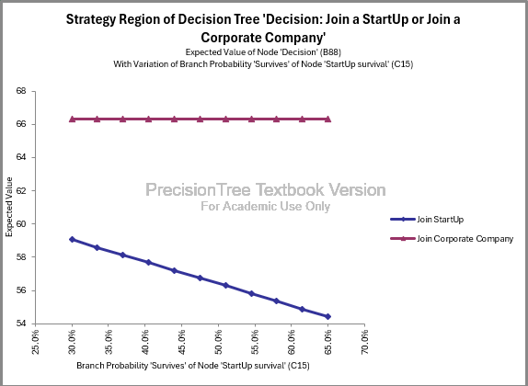
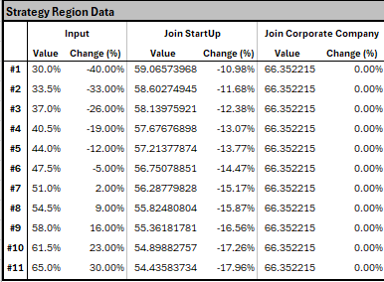
Sensitivity Analysis on Startup Survival

Slide 17
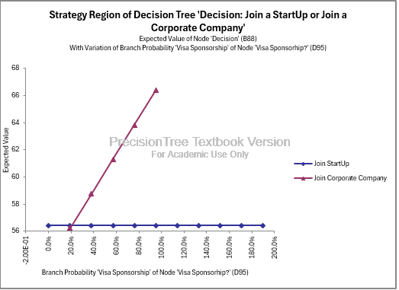
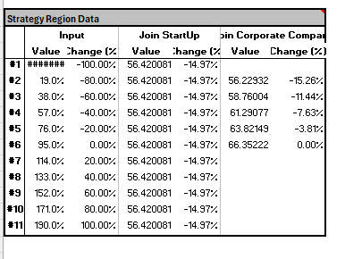
Sensitivity Analysis on Visa Sponsorship

Slide 18
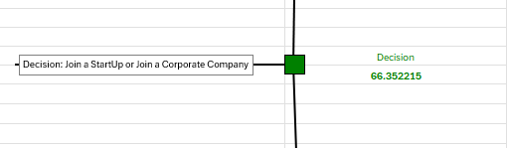
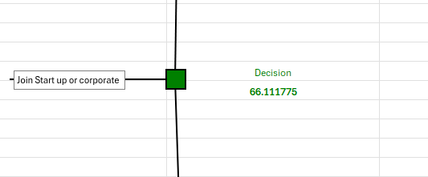
Analysis - Comparison with another weights on objective
Final Utility
92.12962963
51.38888889
67.59259259
51.38888889
73.61166667
32.87092593
40.7412963
32.87092593
100
67.12962963
84.25925926
59.25925926
61.26574074
0
100
67.12962963
84.25925926
59.25925926
61.26574074
0
38.57888889
28.55018519
89.50777778
64.50777778
73.76703704
48.76703704
64.97074074
24.69296296
89.50777778
64.50777778
73.76703704
48.76703704
64.97074074
24.69296296
Final Utility
92.10526316
50
66.66666667
50
74.56192982
32.45666667
40.35140351
32.45666667
100
65.78947368
84.21052632
57.89473684
61.11140351
0
100
65.78947368
84.21052632
57.89473684
61.11140351
0
39.18
28.36333333
90.06
63.74421053
74.27052632
47.95473684
64.62140351
23.39333333
90.06
63.74421053
74.27052632
47.95473684
64.62140351
23.39333333
100
Objectives:
Career Advancement | 90
Salary | 95
Job Satisfaction | 85
 | 270
Normalizing the weights
Career Advancement | 0.333333333
Salary | 0.351851852
Job Satisfaction | 0.314814815
Objectives:
Career Advancement | 100
Salary | 95
Job Satisfaction | 90
 | 285
Normalizing the weights
Career Advancement | 0.350877193
Salary | 0.333333333
Job Satisfaction | 0.315789474
Choose Corporate: 66.35
Choose Corporate: 66.11

Slide 19
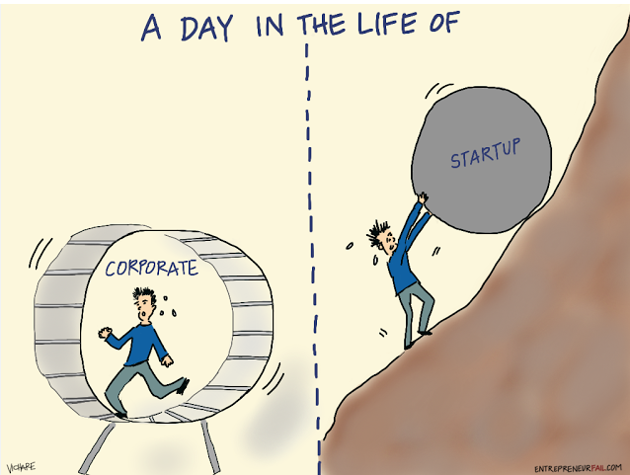
Decision Clarity
Based on Utility Score:
Expected Utility – Corporate: 66.35
Expected Utility – Startup: 56.42
The utility difference is significant, with the corporate path yielding a ~10-point advantage, making it clearly the optimal decision in our model.
The data-backed decision is to join a corporate company, especially if it’s a fast-growing firm with proven visa support and internal mobility.
While startups can offer excitement and equity, the sensitivity analysis does not justify the switch even in best-case survival scenarios, the corporate path is still superior.

Slide 20
Recommendation
Why to join a corporate company:
Much higher chance of visa
Career Growth is more predictable
Lower Risk of job loss or exit
No need to bet on equity payout
Better Long term utility

Slide 21
Appendix
Node/Event | Assigned Probability | Estimation Method & Calculation | Source
Startup Survival (3–5 Years) | 50% | Based on U.S. Bureau of Labor Statistics data on business survival rates. BLS shows ~50% of businesses survive past 5 years. | https://www.bls.gov/bdm/entrepreneurship/entrepreneurship.htm
High Equity if Startup Survives | 30% | Based on startup salary and equity databases. Wellfound/TopStartups.io data show only ~30% of employees receive >0.1% equity. | https://topstartups.io/startup-salary-equity-database/
Visa Sponsorship if High Equity | 60% | Estimated from interviews and hiring data from high-growth startups. Majority of venture-backed startups with high equity options have resources to sponsor. | https://www.onblick.com/blogs/h-1b-visa-guide-for-startups-challenges-winning-moves
High Career Growth (High Equity + Visa) | 75% | Adjusted upward from base startup promotion rates due to high equity, stability, and visa status. Employees in key roles (e.g. those with significant equity) often see faster promotions. | https://www.bettercareer.org/blog/startup-vs-big-company-what-s-best-for-your-career

Slide 22
Higher Studies in USA after No Visa | 35% | Estimated based on internal student surveys and fallback behaviors post-OPT. Students with funding often pursue second Master’s or PhD. | https://www.boundless.com/research/h-1b-work-visa-trends/
Find Job Outside USA after No Visa | 65% | Majority fallback to home country or apply for jobs in India/Canada. NAFSA and Boundless data suggest most transition out if no U.S. sponsorship. | https://www.boundless.com/research/h-1b-work-visa-trends/
Visa Sponsorship in Fast-Growth Corporate | 95% | Based on USCIS and MyVisaJobs H-1B sponsorship approval data. Top firms like Amazon, Google approve thousands of petitions annually. | https://www.uscis.gov/tools/reports-and-studies/h-1b-employer-data-hub
Remote Role Allowed if No Visa (Fast-Growth) | 25% | Remote job data from RemoteOK and Deel reports. Around 1 in 4 companies now support long-term international remote hiring. | https://www.deel.com/blog/global-hiring-report

Slide 23
Exit USA Market if No Remote Allowed | 75% | Complement of remote role probability (1 - 0.25). No visa + no remote = required to exit under USCIS rules. | https://www.uscis.gov
Low Equity if Startup Survives | 70% | Complement of high equity probability (1 - 0.30). Majority of startup employees receive negligible or standard equity grants. | https://topstartups.io/startup-salary-equity-database/
Visa Sponsorship if Low Equity | 30% | Estimated from job listing reviews and F1 alumni interviews. Lower equity correlates with less legal investment from startups. | https://www.onblick.com/blogs/h-1b-visa-guide-for-startups-challenges-winning-moves
High Career Growth (Low Equity + Visa) | 45% | Estimated from team survey of F1 students and Glassdoor reviews. Some career growth possible in support roles with visa sponsorship. | https://www.glassdoor.com

Slide 24
Low Career Growth (Low Equity + Visa) | 55% | Complement of high career growth probability (1 - 0.45). Most low-equity roles are non-strategic with limited visibility. | https://www.glassdoor.com
Visa Sponsorship in Steady-Growth Corporate | 85% | Derived from MyVisaJobs sponsorship records and HR interviews. Large, stable firms frequently sponsor but with more conditions. | https://www.myvisajobs.com
Good Work-Life Balance (Fast-Growth Corporate) | 40% | Derived from employee reviews and culture surveys. Many tech companies promote flexibility, though balance is mixed. | https://hubstaff.com/blog/work-life-balance-statistics
Poor Work-Life Balance (Fast-Growth Corporate) | 60% | Complement of good WLB estimate (1 - 0.40). Scale-up pressure and lean staffing affect balance. | https://hubstaff.com/blog/work-life-balance-statistics

Slide 25
Good Work-Life Balance (Steady-Growth Corporate) | 70% | Based on employee benefit reports and HR policies. Steady corporates typically offer stable work hours and PTO. | https://4dayweek.io/work-life-balance/statistics
Poor Work-Life Balance (Steady-Growth Corporate) | 30% | Complement of good WLB probability (1 - 0.70). Some departments (e.g. consulting, ops) still have pressure. | https://4dayweek.io/work-life-balance/statistics
High Growth (Fast-Growth + Good WLB) | 65% | Estimated from McKinsey’s future of work study. Balanced, innovative teams yield more upward mobility. | https://www.mckinsey.com
Low Growth (Fast-Growth + Good WLB) | 35% | Complement of high growth (1 - 0.65). Growth not guaranteed despite good culture. | https://www.mckinsey.com

Slide 26
High Growth (Fast-Growth + Poor WLB) | 75% | Based on HBR career acceleration studies. Demanding environments lead to faster recognition. | https://hbr.org
Low Growth (Fast-Growth + Poor WLB) | 25% | Complement of high growth (1 - 0.75). Burnout and turnover limit growth for some. | https://hbr.org
High Growth (Steady-Growth + Good WLB) | 40% | Based on LinkedIn alumni career growth insights. Structured promotion paths provide modest advancement. | https://www.linkedin.com
Low Growth (Steady-Growth + Good WLB) | 60% | Complement of high growth (1 - 0.40). Growth often seniority-based. | https://www.linkedin.com

Slide 27
High Growth (Steady-Growth + Poor WLB) | 30% | Observed in niche roles or performance-oriented tracks. Occasional fast promotion via overwork. | https://www.glassdoor.com
Low Growth (Steady-Growth + Poor WLB) | 70% | Majority of roles stay stagnant in low-balance units. Workload not always matched with recognition. | https://www.glassdoor.com

